Slide 1
Salt, Sugar, & Fat Dietary Implications on Chronic Disease
Meg Chen Spielman, MA, RD, CDE, LD
April 27, 2013
Notes:
Public health officials have expressed alarm in recent years at the growth of diabetes and obesity in recent years among Americans and their relationship to sweet and saltly, often fat-laden processed foods.

Slide 2
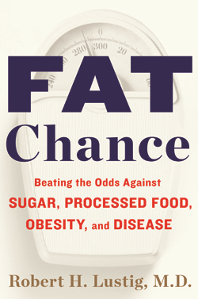
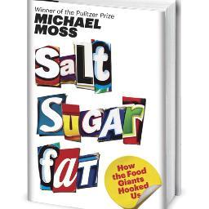
Notes:
Michael Moss, has spent years covering American food companies. In his latest book, he looks at food industry labs where scientists carefully craft snacks, dessert, and processed meals we just can’t resist. He is an investigative reporter for the NY Times and he won a Pulitzer Prize in 2010 on the series on the dangers of contaminated meat. Dr. Lustig is a pediatric endocrinologist and director of the Weight Assessment for Tean and Child Health Program at UCSF Center for Obesity Assessment, Study, and Treatment.

Slide 3
Adult Obesity Facts
Obesity is common, serious, and costly
More than 1/3 of U.S. adults (37.5%) are obese
Obesity-related conditions include heart disease, stroke, type 2 diabetes and certain types of cancer, some of the leading causes of preventable death.
In 2008, medical costs associated with obesity were estimated at $147 billion; the medical costs for people who are obese were $1,429 higher than those of normal weight.
Obesity affects some groups more than others
Non-Hispanic blacks have the highest age-adjusted rates of obesity (49.5%) compared with Mexican Americans (40.4%), all Hispanics (39.1%) and non-Hispanic whites (34.3%) [See JAMA. 2012;307(5):491-497. doi:10.1001/jama.2012.39].
Notes:
Source: http://www.cdc.gov/obesity/data/adult.html

Slide 4
Adult Obesity Facts (continued)
Obesity and socioeconomic status
Among non-Hispanic black and Mexican-American men, those with higher incomes are more likely to be obese than those with low income.
Higher income women are less likely to be obese than low-income women.
There is no significant relationship between obesity and education among men. Among women, however, there is a trend—those with college degrees are less likely to be obese compared with less educated women.
Between 1988–1994 and 2007–2008 the prevalence of obesity increased in adults at all income and education levels.

Slide 5

Obesity Trends Among U.S. Adults Between 1985 and 2010
Definitions:
Obesity: Body Mass Index (BMI) of 30 or higher.
Body Mass Index (BMI): A measure of an adult’s weight in relation to his or her height, specifically the adult’s weight in kilograms divided by the square of his or her height in meters.

Slide 6
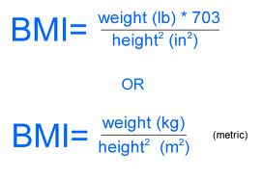
How is BMI calculated and interpreted?
Example: Joe is 5’10”, 200 lbs, What is his BMI?
5’10”= 70” ; 70 x 2.54 = 177.8 cm = 1.778 m
200 lbs ÷ 2.2 = 90.9 kg
BMI = 90.9 kg ÷ (1.778)² ⁼ 28.75

Slide 7
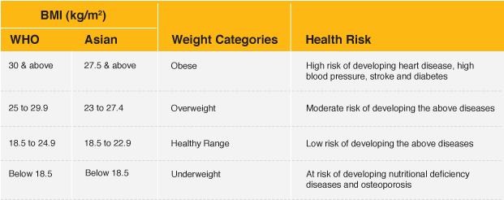
BMI Chart and Health Risk

Slide 8
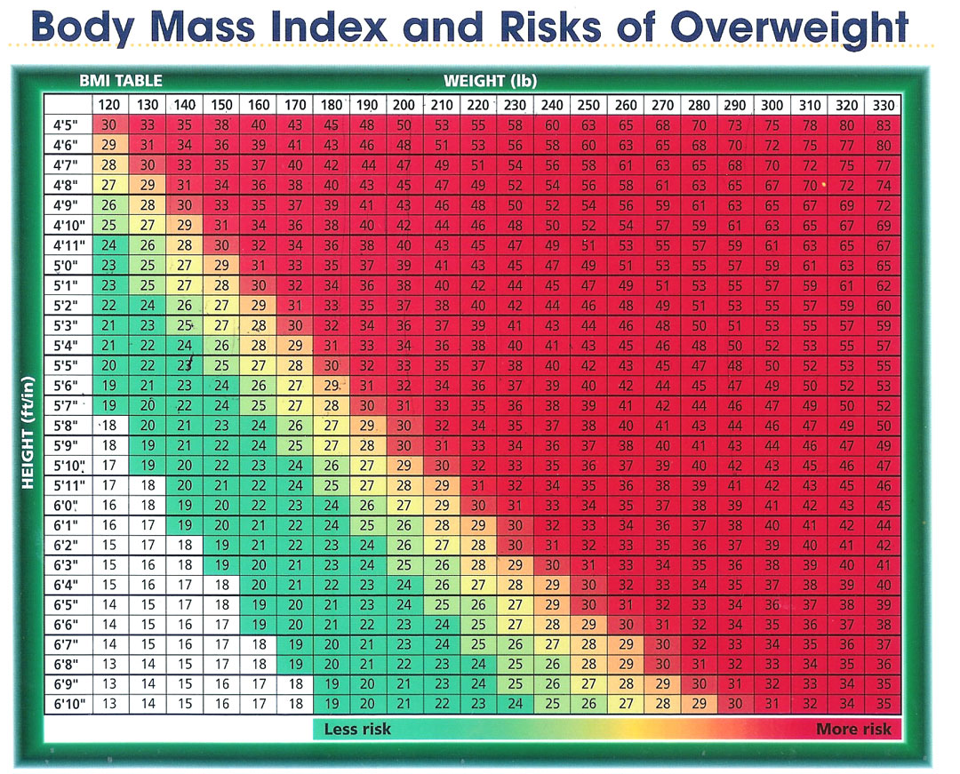

Slide 9
Obesity Trends Among U.S. Adults Between 1985 and 2010
Source of the data:
The data shown in these maps were collected through CDC’s Behavioral Risk Factor Surveillance System (BRFSS). Each year, state health departments use standard procedures to collect data through a series of telephone interviews with U.S. adults. Height and weight data are self-reported.
Prevalence estimates generated for the maps may vary slightly from those generated for the states by BRFSS (http://aps.nccd.cdc.gov/brfss) as slightly different analytic methods are used.

Slide 10
In 1990, among states participating in the Behavioral Risk Factor Surveillance System, 10 states had a prevalence of obesity less than 10% and no state had prevalence equal to or greater than 15%.
By 2000, no state had a prevalence of obesity less than 10%, 23 states had a prevalence between 20–24%, and no state had prevalence equal to or greater than 25%.
In 2010, no state had a prevalence of obesity less than 20%. Thirty-six states had a prevalence equal to or greater than 25%; 12 of these states (Alabama, Arkansas, Kentucky, Louisiana, Michigan, Mississippi, Missouri, Oklahoma, South Carolina, Tennessee, Texas, and West Virginia) had a prevalence equal to or greater than 30%.

Slide 11
Obesity Trends* Among U.S. Adults BRFSS, 1990, 2000, 2010
(*BMI ≥30, or about 30 lbs. overweight for 5’4” person)
1990
2000
2010
No Data <10% 10%–14% 15%–19% 20%–24% 25%–29% ≥30%

Slide 12
A Calorie is a Calorie—or Is It?
The prevailing wisdom: a calorie is a calorie
Comes from the first law of thermodynamics: “the total energy inside a closed system remains constant”.
From this dogma comes the standard and widely held interpretation of the first law: “If you eat it, you had better burn it, or you will store it”.
Dr. Lustig argues that that: A calorie is not a calorie.

Slide 13
3 Contraindications to the current dogma…
First: There is no way anyone can actually burn off the calories supplied by our current food supply. The body is smarter than the brain is. Energy expenditure is reduced to meet the decreased energy intake
Second: If a calorie is a calorie, then all fats would be the same because they’d each release 9 calories per gram when burned off. But all fats are not the same (good fats vs. bad fats). All carbohydrates are not the same (complex vs. simple).

Slide 14
Contraindications continued
Third: We’re eating more of some things and less of others. And in those “some things” we will find our answer to the obesity pandemic.
The total consumption of protein and fat remained constant as the obesity pandemic accelerated. The intake of fat declined as a percentage of total calories (from 40% to 30%) . Protein intake remained relatively constant at 15%. However carbohydrate increased from 40% to 50%, specifically fructose. The answer to the dilemma likes in understanding the causes and effects of these changes in our diet.

Slide 15
So a calorie burned is a calorie burned, but
A calorie eaten is not a calorie eaten.
The quality of what we eat determines the quantity. It also determines our desire to burn it.

Slide 16
In 1999…
…there was private meeting among top officials at some of the largest U.S. food companies brought together for this extraordinary moment when they were told that obesity is surging along with other health issues and the industry was coming to a moment in time when in needed to start wrestling with the health issues in terms of accepting responsibility for at least part of the obesity crisis and holding themselves accountable for coming up with at least part of the solution.
Notes:
The main presenter of this meeting was a senior official (Michael Mudd) at the largest food giant—Kraft--no prompted by activists or regulators! Who in the years leading up to the meeting had become increasing concerned about the looming obesity crisis and the fate of his industry. In the presentation, he was pleading with CEOs to pay attention to the issue and start thinking about the things they could do collectively to turn the corner. He talked about marketing especially those directed at children, because they are so susceptible esp. to sugary foods in the ways that our bodies are hardwired for sugar and all 10,000 taste buds are connected to the brain and tell you to eat sweet food when you get some. He also went beyond this too to press upon the actual formulation of foods—have they gone too far in making their foods too be utmost attractive and alluring to people. This was on the table and generated somewhat hostile, defensive reaction from the CEOs. 1st reaction came from General Mills CEO, said some forceful points: we at General Mills have been responsible not only to consumers but shareholders; we offer products that are low fat, low sugar, have whole grains in them to those people who are concerned about eating those products, bottom line being though we need to ensure our products taste good because our accountability is also to our shareholders and there is no way we can start down-formulating the useage of salt, sugar, fat across the board if the end result is going to be something that people will not want to eat.

Slide 17
What happened?
GM’s CEO forceful response ended the meeting
Kraft’s Michael Mudd was looking at a minimum of a pool of $15 million dollars from all the companies to start researching the causes of obesity.
Some of the companies, esp. Kraft decided to go at the issue unilaterally on their own.
Kraft decided to push ahead, do the right thing by consumer health without pulling the rest of the industry along with it—an extraordinary move by the company
Most of the companies kept doing what they were doing...making the most convenient, the most long-lasting, the least-cost foods they could.
Notes:
These food companies are profit-driven, they are additive to profit as much as we are addicted salt, sugar and fat.

Slide 18
What do we know about sugar?
Our bodies are hard-wired for sweets.
The tongue map is wrong (creators misinterpreted the work of a German graduate student in 1901): Bitter—back; Sour & salty—back; Sweet-tip of tongue
There are special receptors for sweetness in every one of the mouth’s 10,000 taste buds.
Scientists are finding taste buds all the way down our esophagus to our stomach and pancreas, and they appear to be intricately tied to our appetites.
Sugar addiction has been demonstrated addictive in studies in rats and human studies.

Slide 19
What do we know about sugar? (continued)
“Bliss point”: a mathematical term that was applied to food in the 1970s by a food scientist—Howard Moskowitz--working in the U.S. Army developing food rations for soldiers in the field, trying to get them to eat more in the field.
The magical point at where sugar was at an optimum level for creating allure.
Manufacturers also use sugar not only for flavor, but use it to make food better, bigger, look better in appearance, coloring, and texture.

Slide 20
Food Industry
Companies are altering physical shape and structure
Nestle—fiddling with the distribution and shape of fat globules to affect their absorption rate and “mouthfeel”
Cargill—altering the physical shape of salt, pulverizing it into a fine powder to hit the taste buds faster and harder, improving “flavor burst”.
Sugar
has been crystallized into an additive that boost the allure of foods
Scientists have created enhancers that amplify the sweetness of sugar to 200x its natural strength

